Slide 1
Super Bowl LVIII Assignment

Slide 2
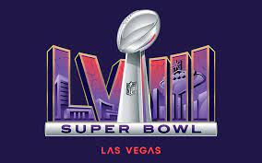
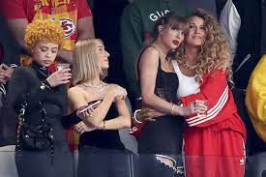
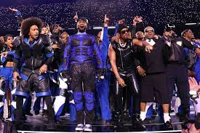
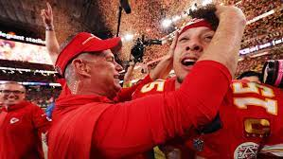
Two Main Topics:
Economic Impact on Host City
Broadcasting Rights and Advertising

Slide 3
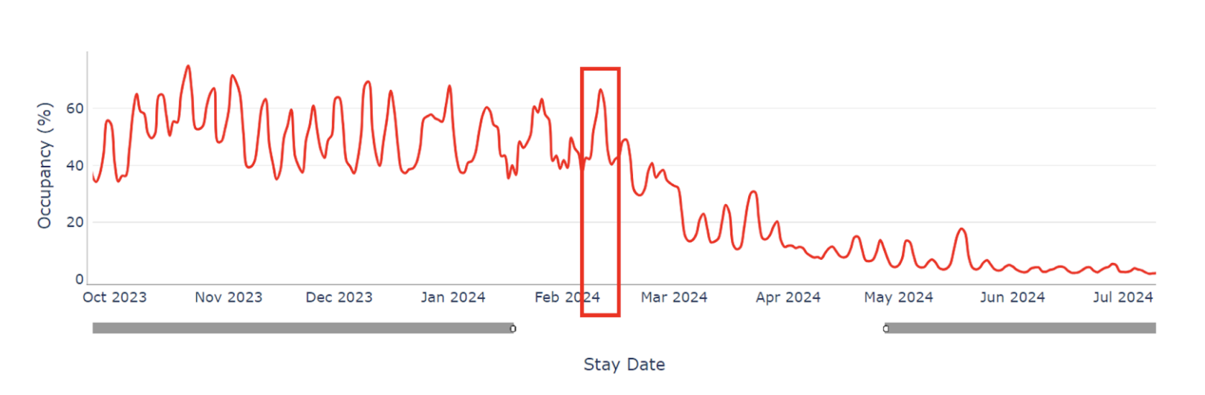
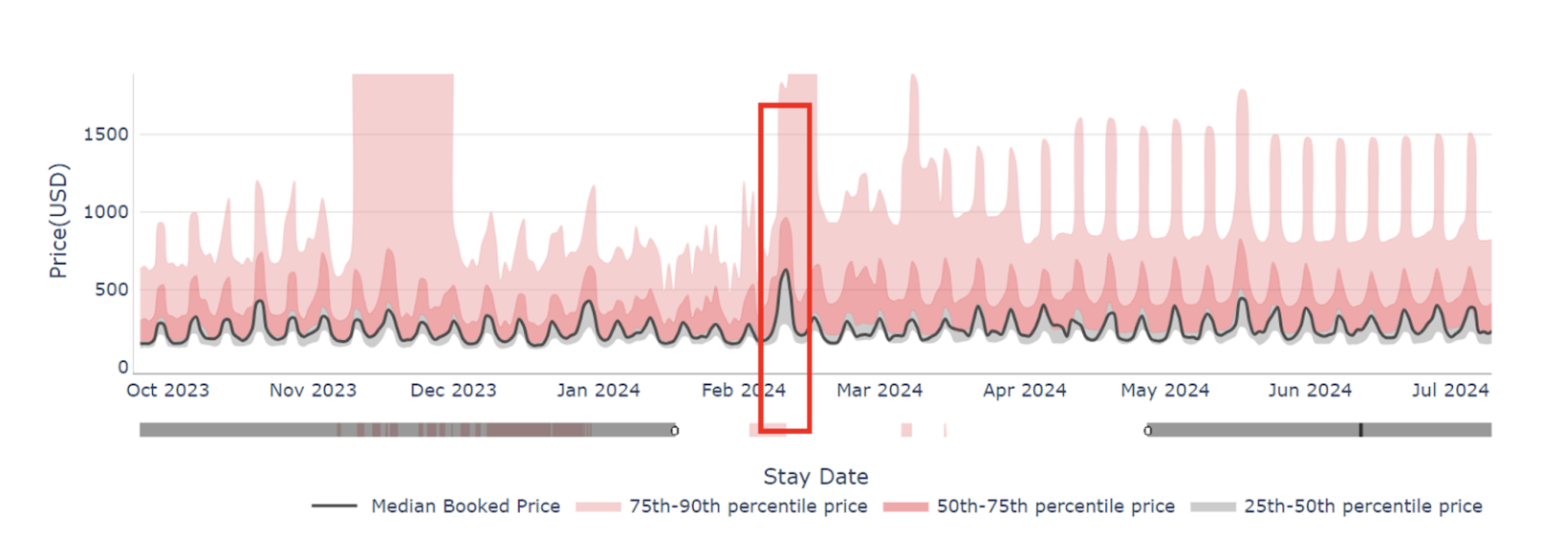
Economic Impact on Host City
2024
Occupancy rates increased by 14%
Average Daily Rate (people going to Vegas) surging by 2.33 times
Revenue Per Available Room (hotels) skyrocketing by 3.08 times
Hitting higher numbers from the years before
2024 Super Bowl broke records, boasting a 16% increase in viewership

Slide 4
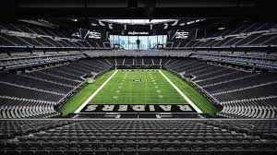
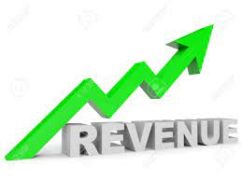
Positive Economic Impact:
Nevada sportsbooks took in a historic amount wagered, $185.6 million in bets.
Generate an additional $500 million for the Las Vegas local economy
150,000 visitors to the city who are forecast to spend $215 million in spending on food and beverages, hotel rooms, game-related merchandise for local businesses
Occupancy rate of nearly 88 percent
Draw about 330,000 visitors to Las Vegas and drive an economic impact of $600 million
Consumers in Southern Nevada will spend $136.6 million at retail outlets.

Slide 5
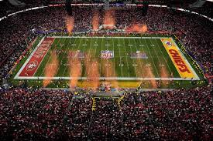
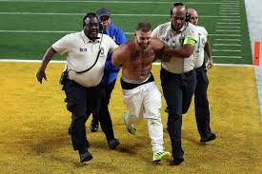
Negative Economic Impact:
Congestion of people
Safety
Drunken Crowds, and Drinking and Driving
Increased Security
deployment of over 385 DHS employees, temporary flight restrictions by the FAA and the creation of a tip line for the public and game attendees can report suspicious activity.
Illegal Gambling
Rigging the game
Environmental impact
Clean up

Slide 6

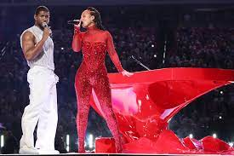
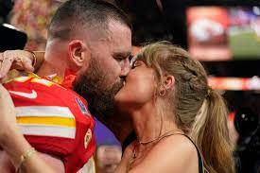
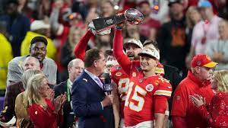
Economic Impact/Broadcasting
Contributing Factors:
Increased interest Taylor Swift
Kansas City doing it again
Competitive game towards the end
Change in rules
Halftime Show

Slide 7
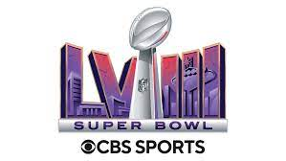
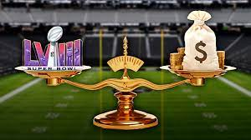


Broadcasting Rights and Advertising
CBS broadcasted Super Bowl 58
CBS are locked up through 2033, for about $2 billion a year to the NFL
Contracts for NFL game throughout season: Fox ($2.2 billion), NBC ($2 billion), CBS ($2.1 billion)
Streaming Services: Amazon Prime pays $1 billion just for the "Thursday Night Football" window alone.
Consumers are using streaming devices to watch sports 6 million watched Super Bowl LV on online platforms.
$7 million for a 30-second unit on CBS
Celebrity appearances: Kanye!!
Temu Doubling down

Slide 8
Sources:
https://hello.pricelabs.co/data-insights-from-2024-super-bowl/
https://www.reviewjournal.com/business/tourism/touchdown-super-bowl-brings-big-economic-victory-to-las-vegas-3000485/
https://www.cbsnews.com/news/super-bowl-2024-las-vegas-economic-impact/
https://cnr.ncsu.edu/news/2020/11/sport-environment-connection/
https://www.usatoday.com/story/sports/nfl/2024/02/09/vegas-super-bowl-security/72541136007/
https://www.usatoday.com/story/sports/nfl/columnist/bell/2024/02/05/super-bowl-2024-nfl-integrity-las-vegas-gambling-capital/72478020007/
https://frontofficesports.com/does-the-vegas-super-bowl-make-economic-sense-depends-where-you-get-your-figures/
https://www.washingtonpost.com/opinions/2024/02/07/vegas-superbowl-sports-boom/
https://www.broadcastlawblog.com/2024/02/articles/2024-update-on-super-bowl-advertising-and-promotions/
https://mnrepublic.com/9976/sports/super-bowl-58-a-game-changer-in-television-viewership-and-ad-revenue/
https://www.sportingnews.com/us/nfl/news/broadcasting-super-bowl-channel-announcers-super-bowl-58/e1f072c2b5cd07e4d17a8b8d

